Slide 1
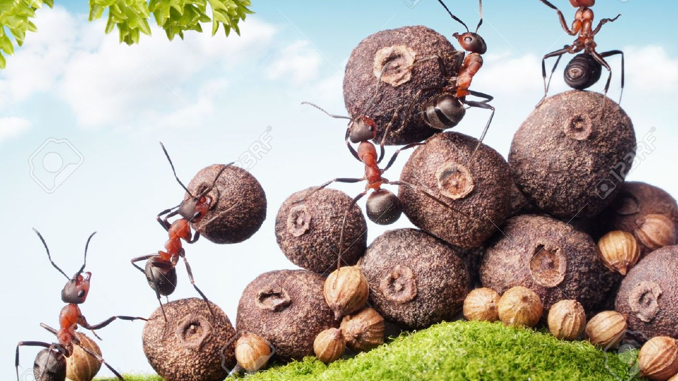
Ants vs. The WOrld
Cynthia Lopez

Slide 2
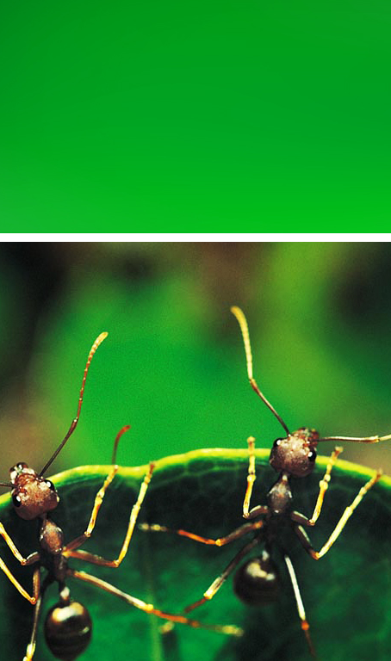
Story Summary
The main character is an ant and can explore its surroundings. The ant must survive different obstacles. The object of the game is to see how long you can survive being an ant. The idea is that the ant will have to ability to evolve into different stages of life.
For example it will start off in a forest as a larva, next the scene will transition to a local park as an adult, and finally the city. Once you pass all levels, you are free to explore the world (open-world).

Slide 3
Overview
The targeted audience is for people who enjoy indie/survival game. Ages 13+ (May contain violence, suggestive themes, crude humor, minimal blood, simulated gambling, and/or infrequent use of strong language)
Survival game/single player game
Highly individualized: determined by the abilities of a specific player
Unity 3D

Slide 4
Formal Elements
Players
There were only be one player for this game. This game is meant for the player to solo experience
Procedures
The player is bounded/limited to only explore the area in the level they are in.
Controls: basic WASD, space = speeding up, 1-5 select inventory items, enter = consume item/escape
Objective
The player needs to survive for as long as possible. The player has finite resources. The game will consist of exploration
Rules
Limited stamina, lives, food, and armor.
Food and armor are collectables laid around the map
Need avoid objects such as:
Humans
Water (e.g. rain drops, rivers, lakes, swimming pool etc.)

Slide 5
Formal elements
Conflict
Obstacles (objects)
physical: humans, water, buildings, or heavy obstacles.
Resources (Scarcity)
Lives (3)
Health
Armor
Food
Boundaries
Physical: edges of the map, obstacles in the map
Outcome
The player would win the game for surviving the entire game and will be able to play after the game has finished (open-world games)

Slide 6
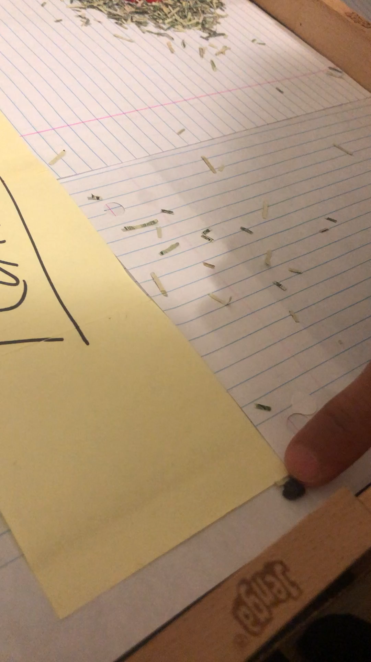
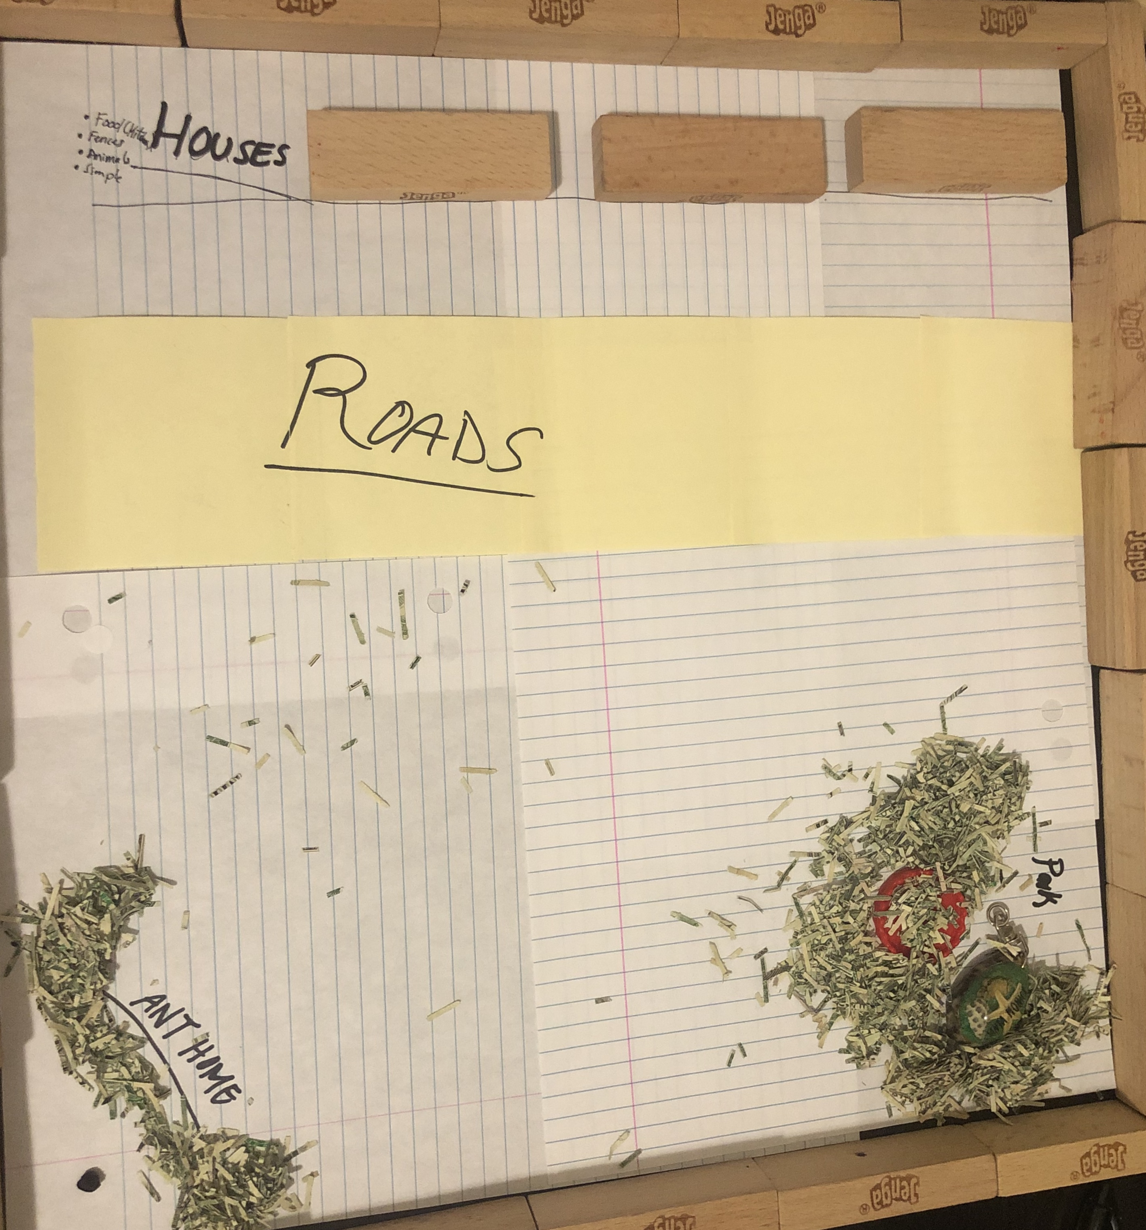
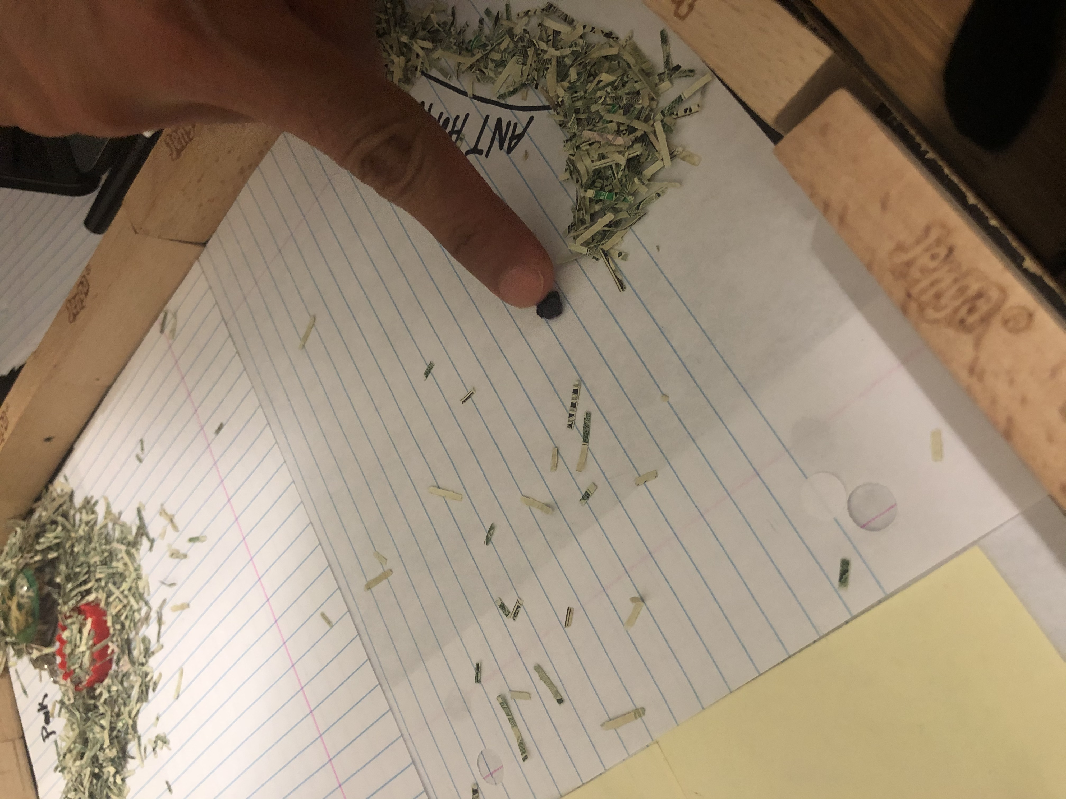
Prototype (Suburb Scene)
park

Slide 7
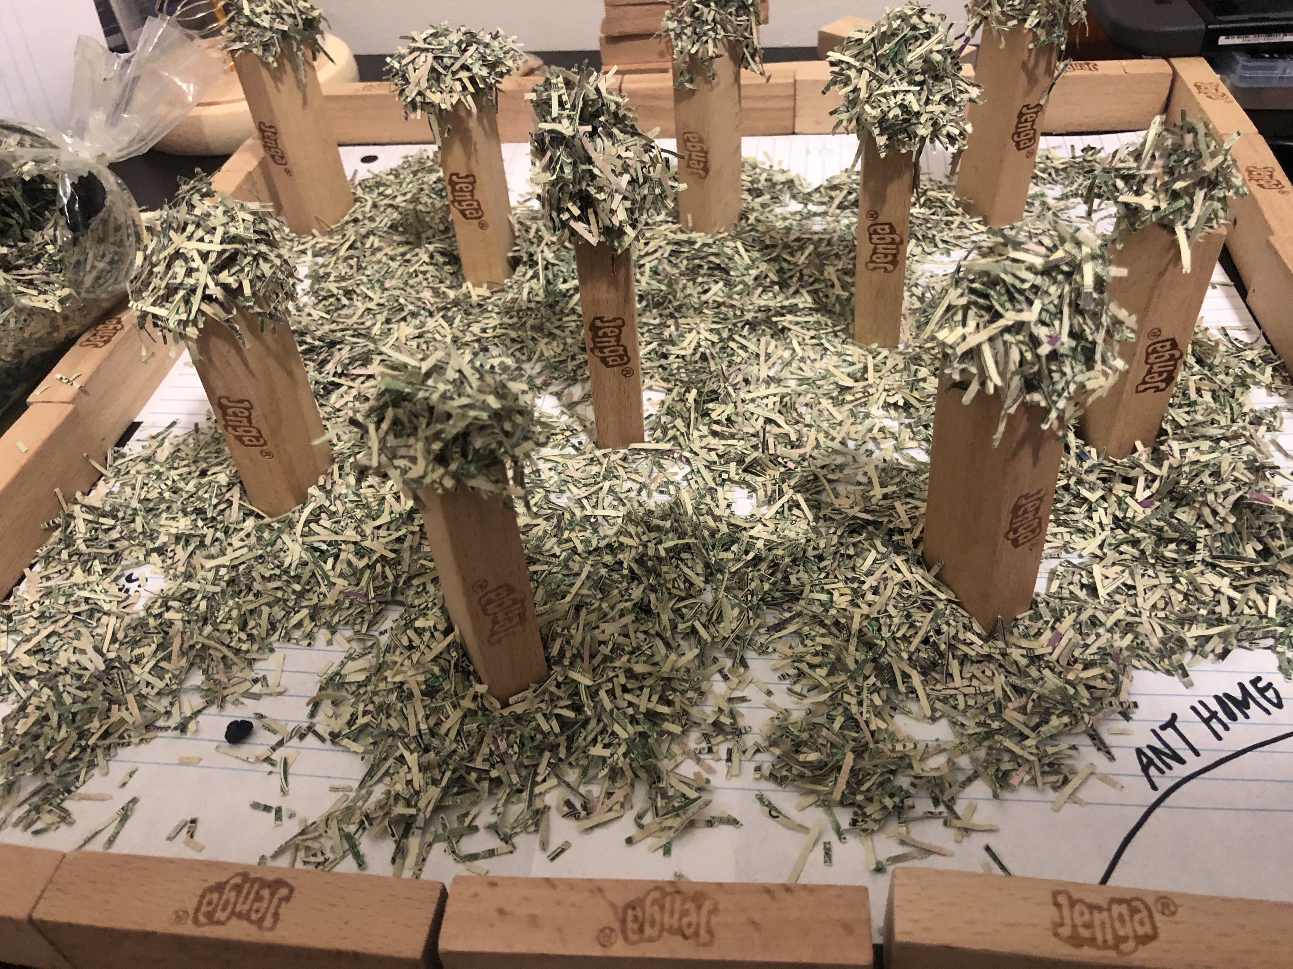
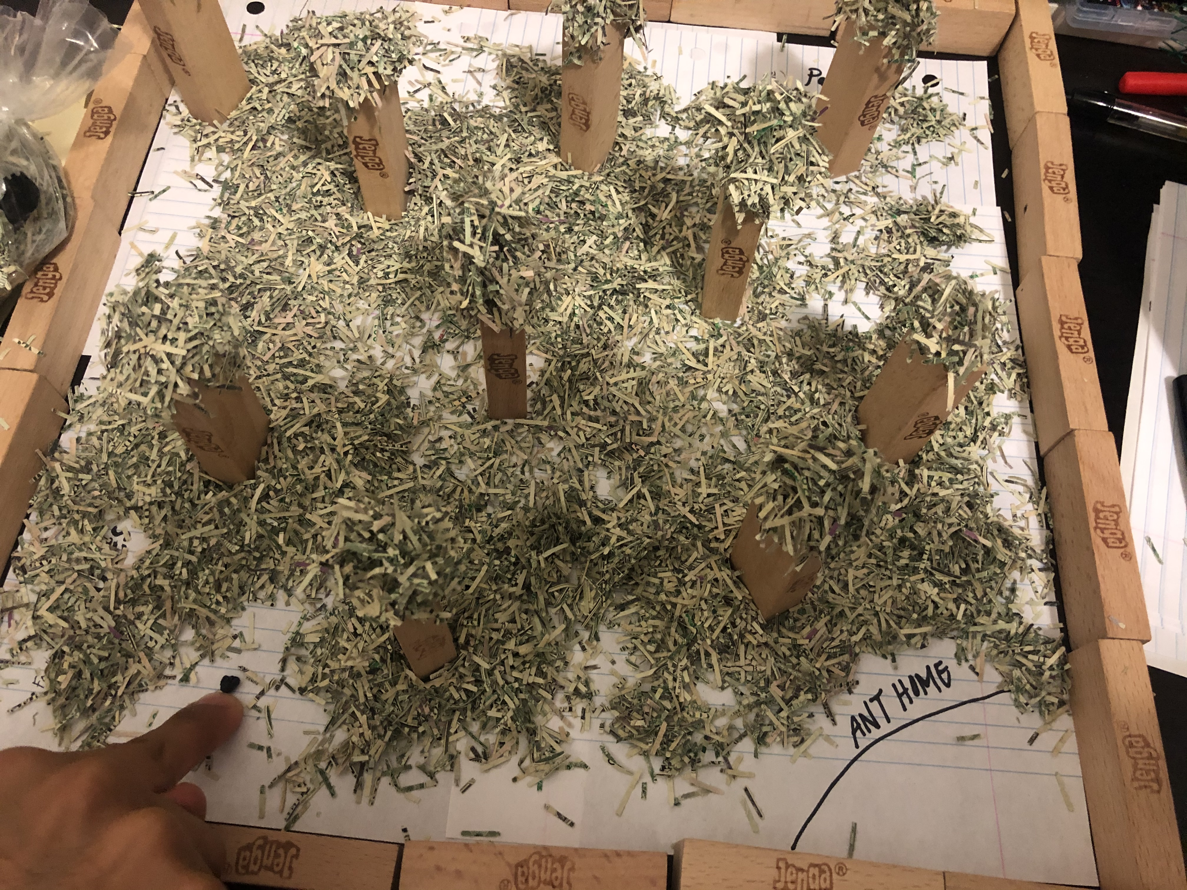
Prototype (Forest Scene)
Treees

Slide 8
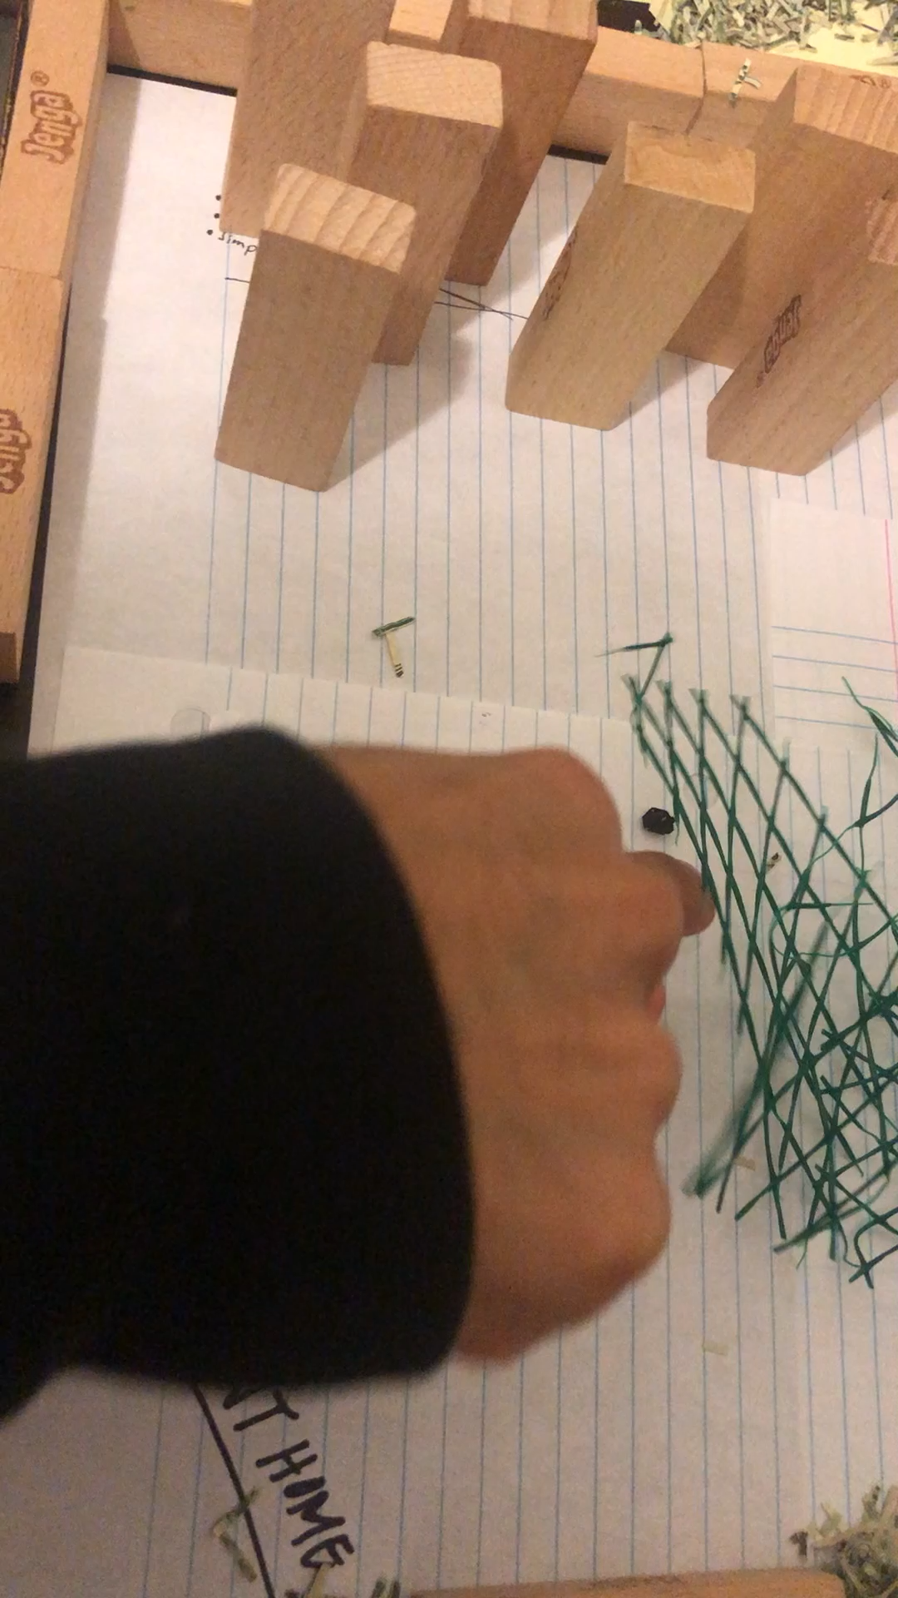
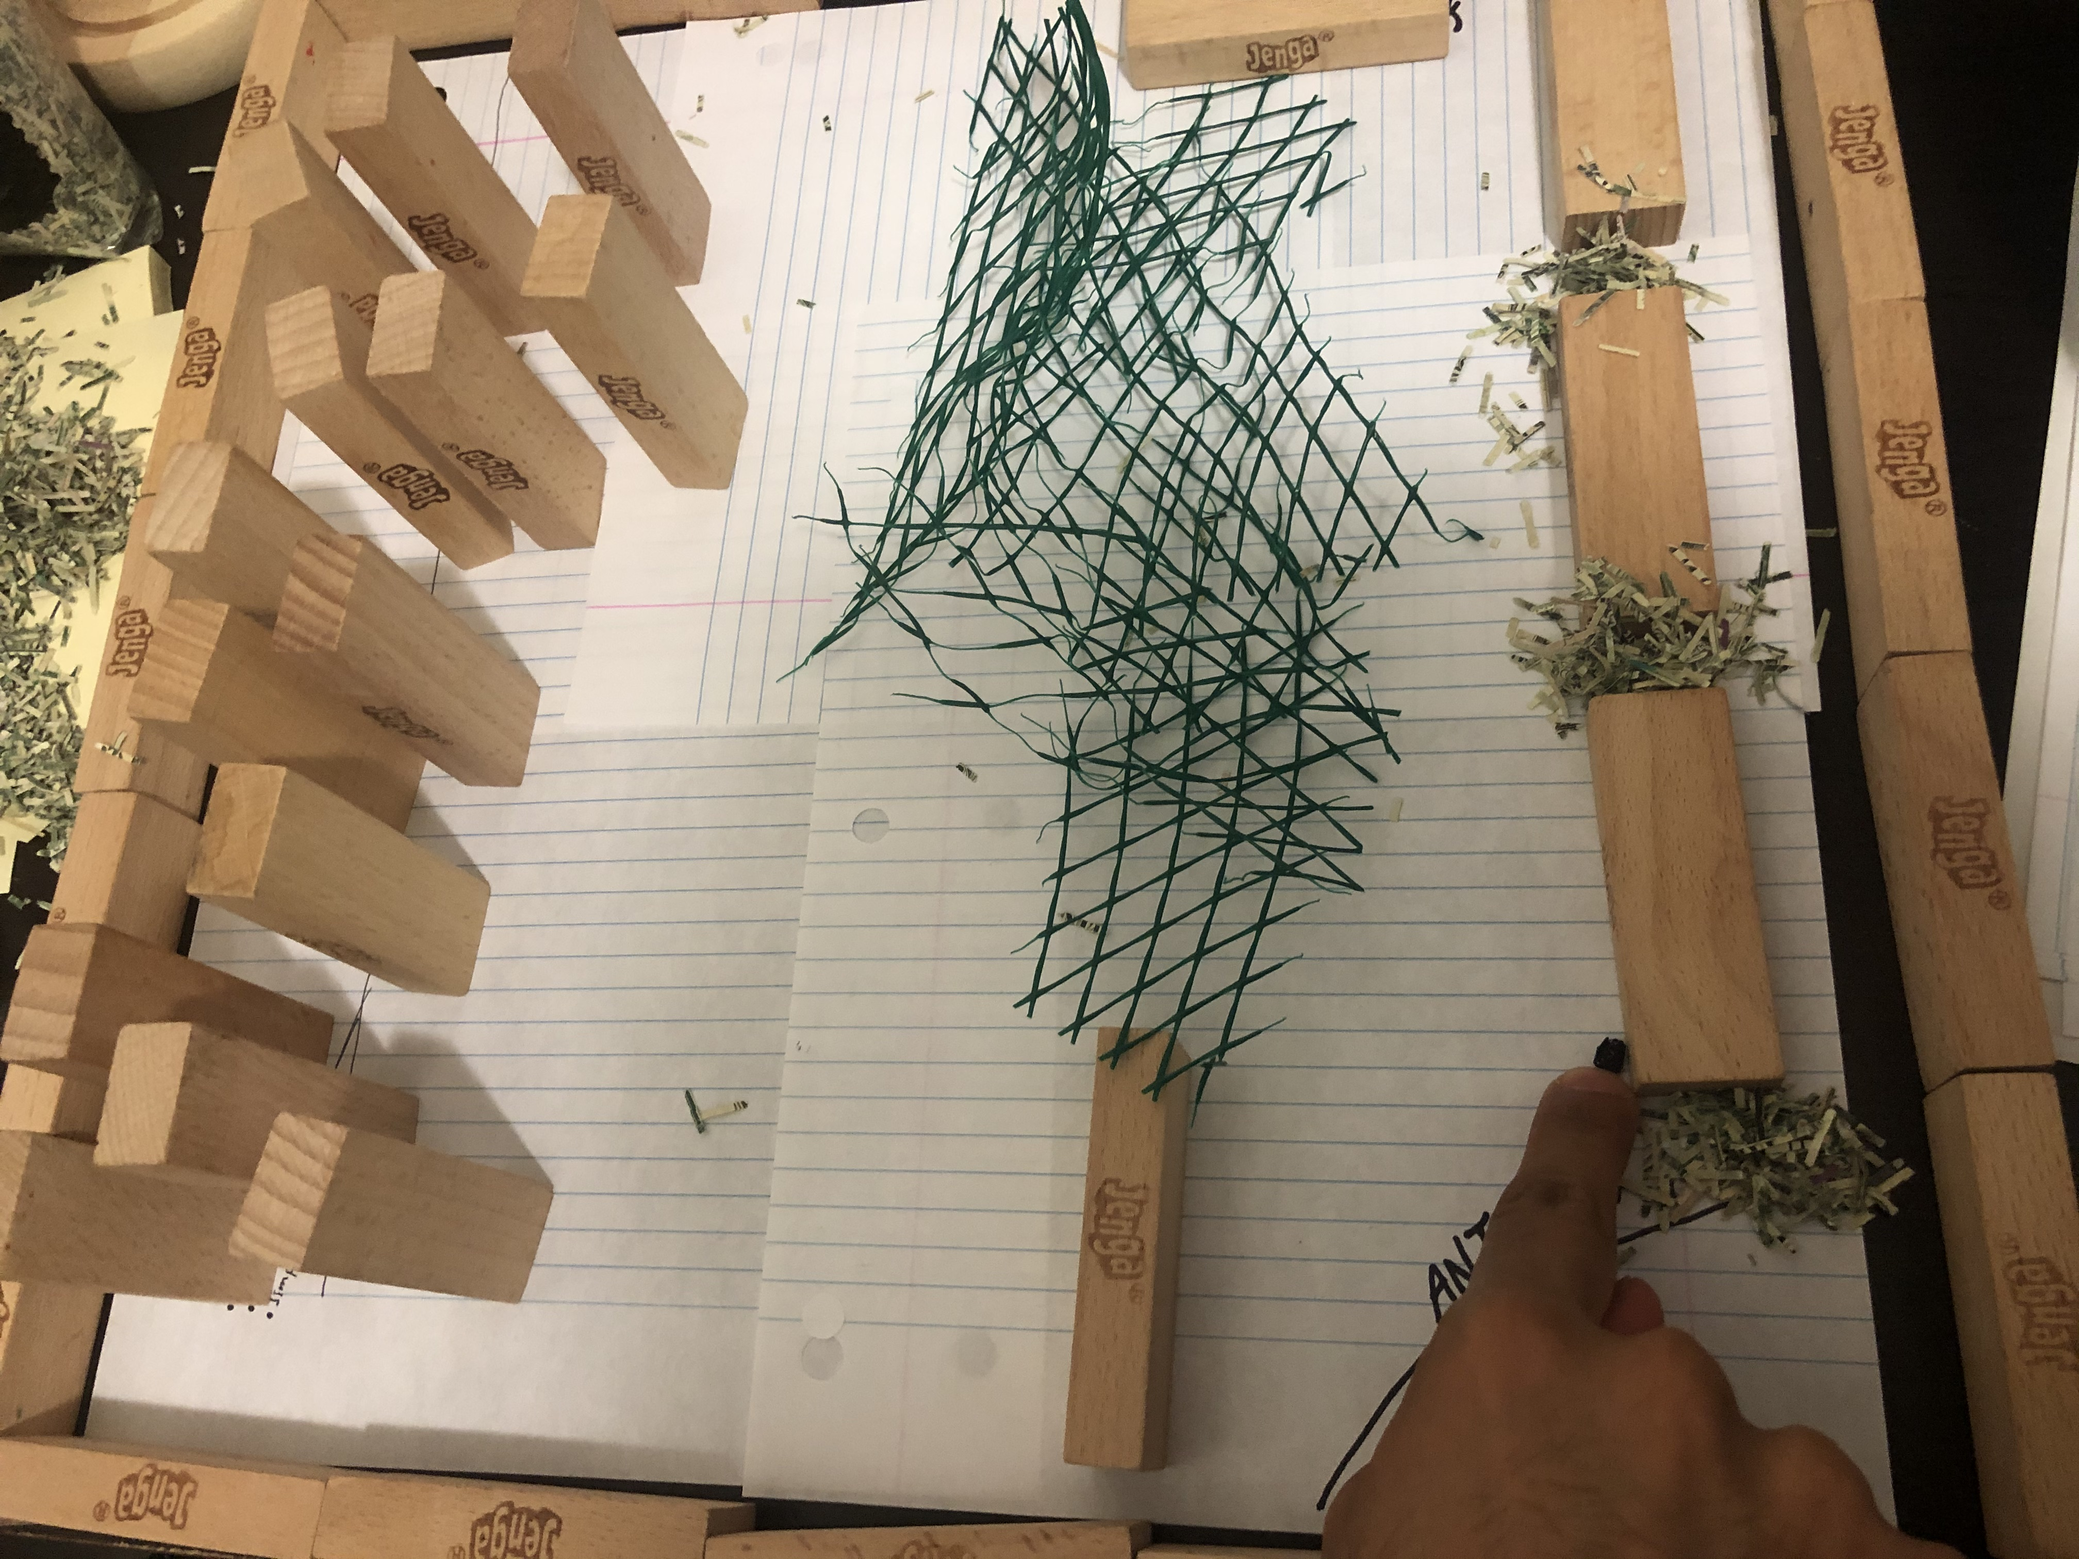
Prototype (City Scene)
Houses
Buildings
Fences

